Slide 1

2025 제6회 전자구조계산 여름학교
ABC DEF
GIST
Dongbin Shin

Slide 2
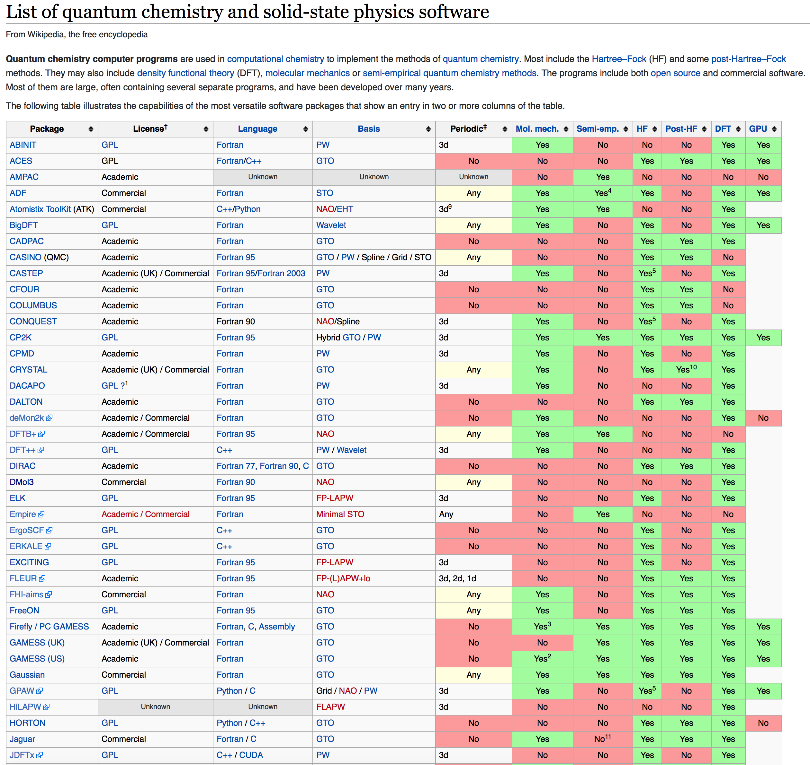



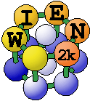
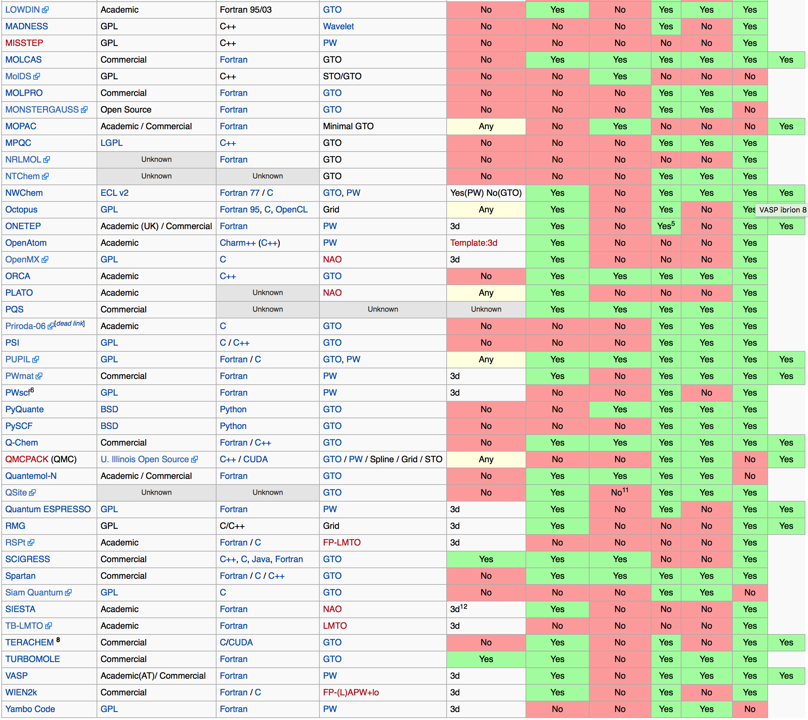





DFT packages
List of Quantum chemistry and solid-state physics software
Gaussian orbital
Numerical atomic orbital
Plane wave
Augmented plane wave
Numerical grid
Gaussian+PW
Hybrid basis set

Slide 3

What can QE do?
DFT (pw.x)
SCF; ground state electronic structure
Structure optimization
Ab initio MD
NEB (neb.x)
Band structure (band.x)
PDOS (projwfc.x)
Partial charge density (pp.x)
DFPT
Density functional perturbation theory
Many-body PT
Pseudopotential generation (ld1.x)
CPMD (cp.x)
Wannier function (pw2wannier90.x)
X-spectra (xspectra.x)
Ballistic conductance (pwcond.x)
rtp-TDDFT (td.x)
Phonon (ph.x)
el-ph interaction (ph.x)
lr-TDDFT (turbo_*.x)
GW(Yambo)
BSE(Yambo)
DFT+DMFT(AMULET)

Slide 4
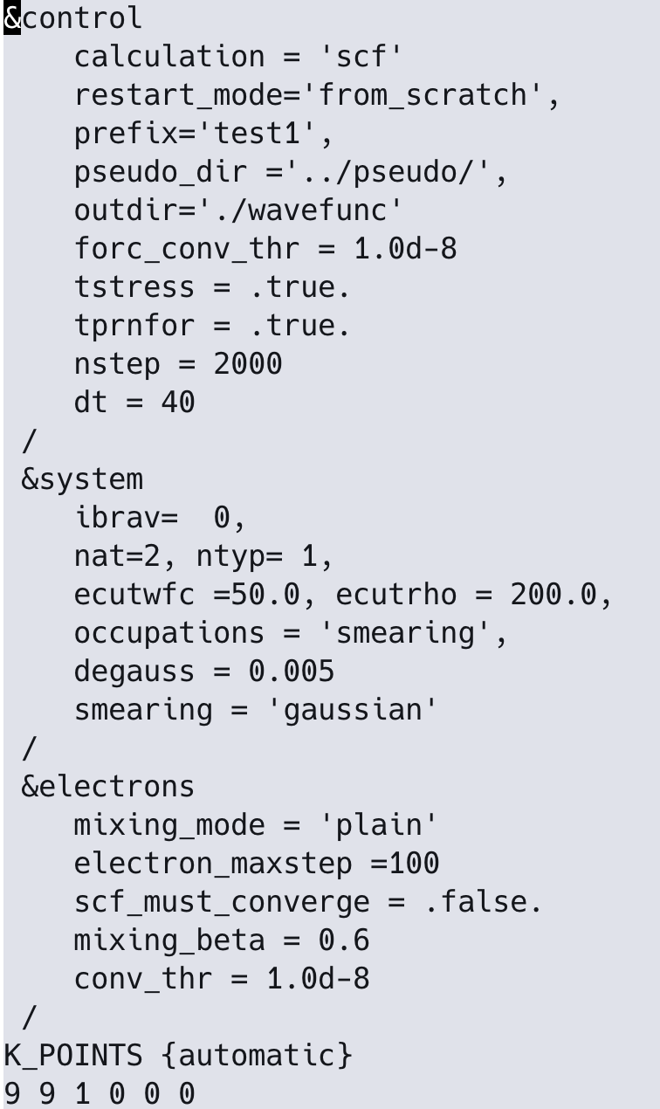
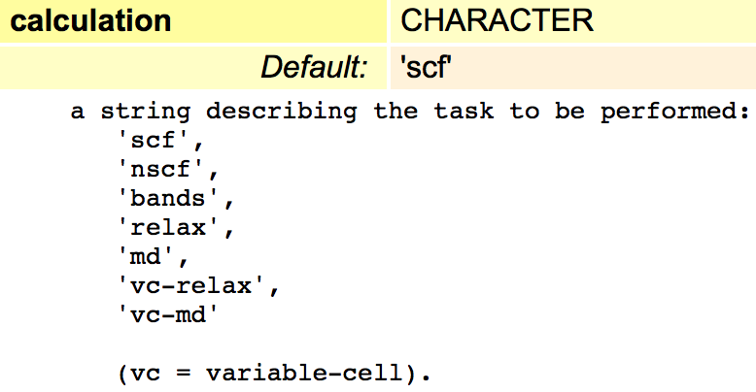
Pw.x input description - control
calculation = ‘scf’
No
Yes
Terminate

Slide 5
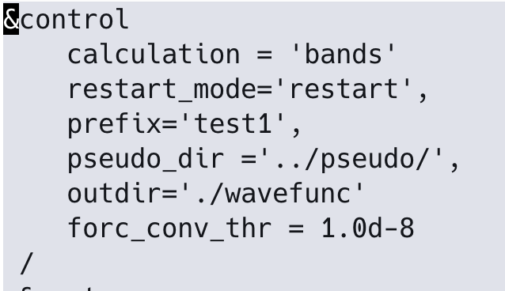
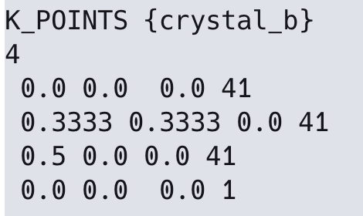
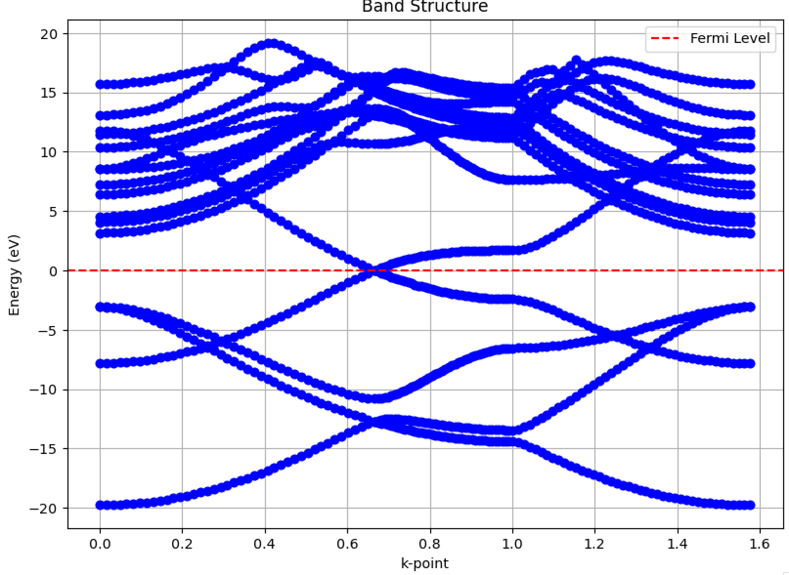
Pw.x input description - control
calculation = ‘band’
Terminate

Slide 6
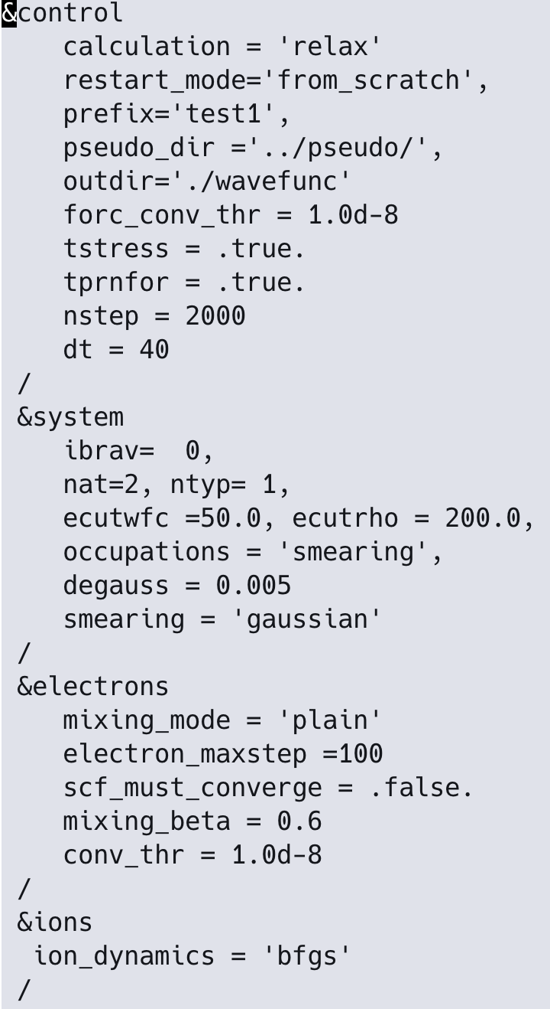
Pw.x input description - control
calculation = ‘relax’
No
Yes
No
Yes
Terminate

Slide 7
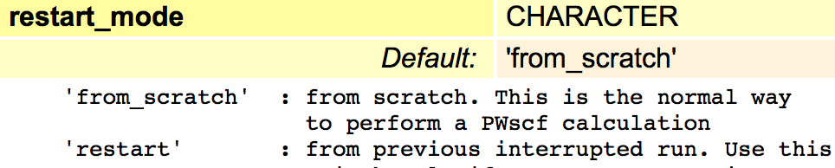
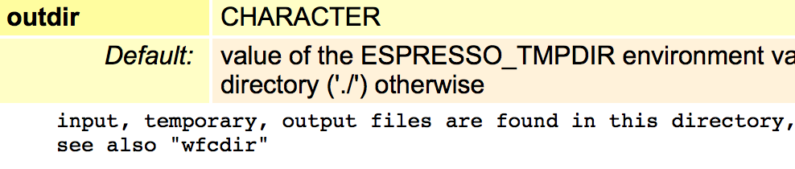
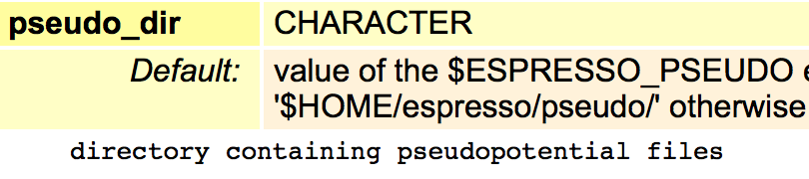
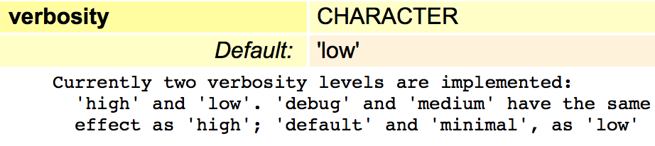
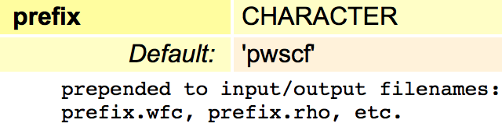
Pw.x input description - control

Slide 8
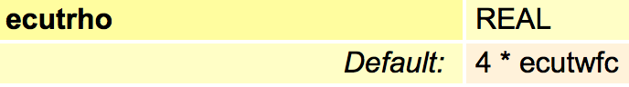
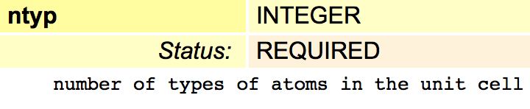
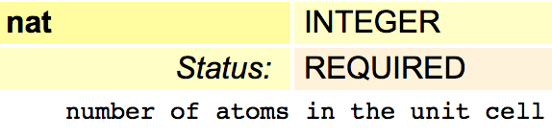
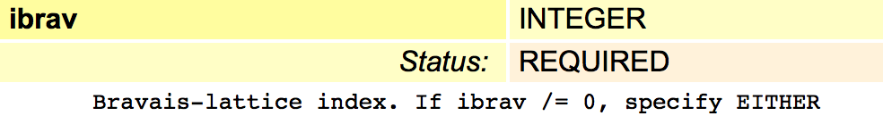
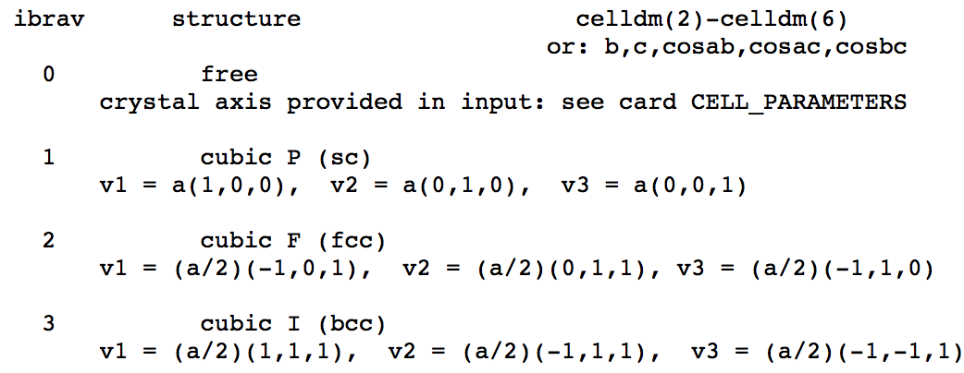
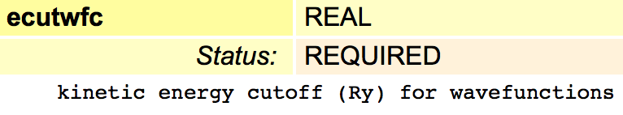
Pw.x input description - system

Slide 9
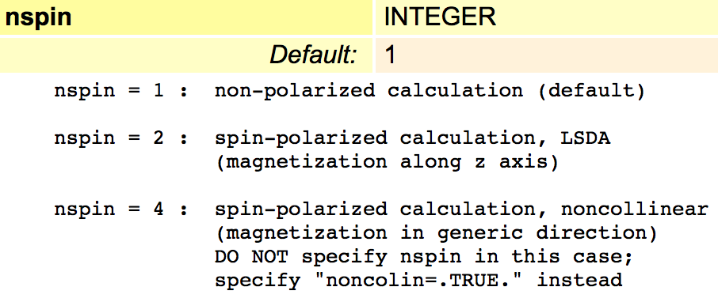
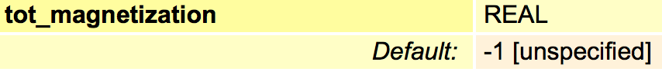
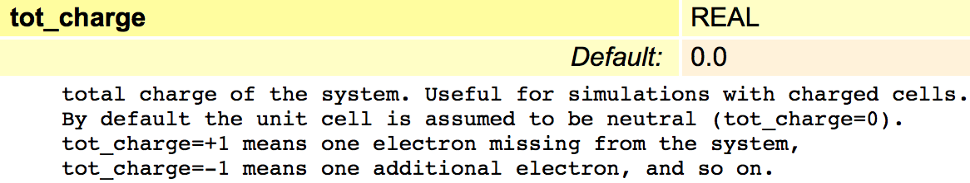
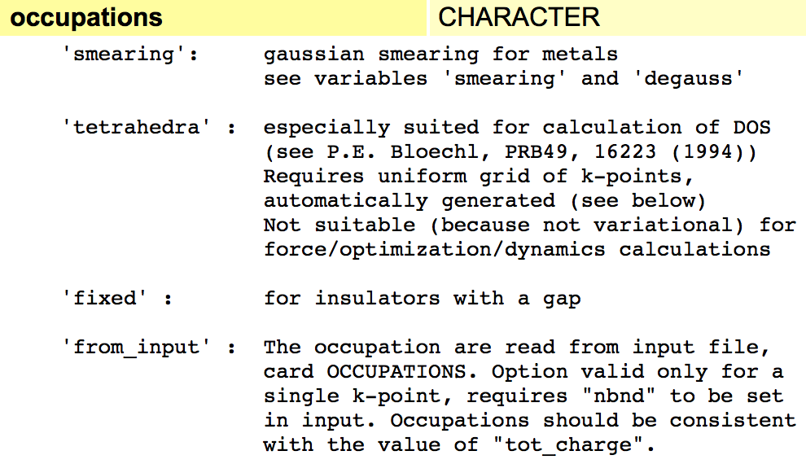
Pw.x input description - system
Efield, Hubbard U, Hybrid functional, esm

Slide 10
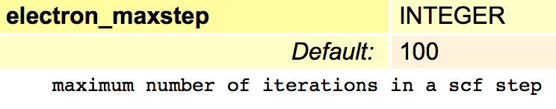
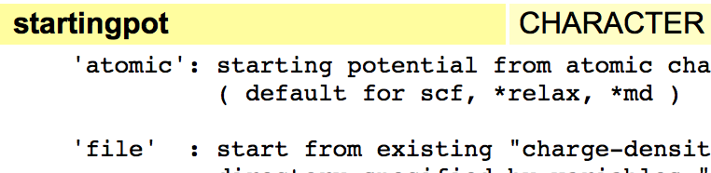
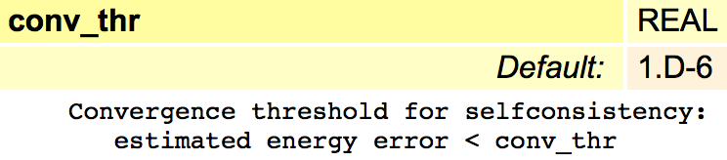
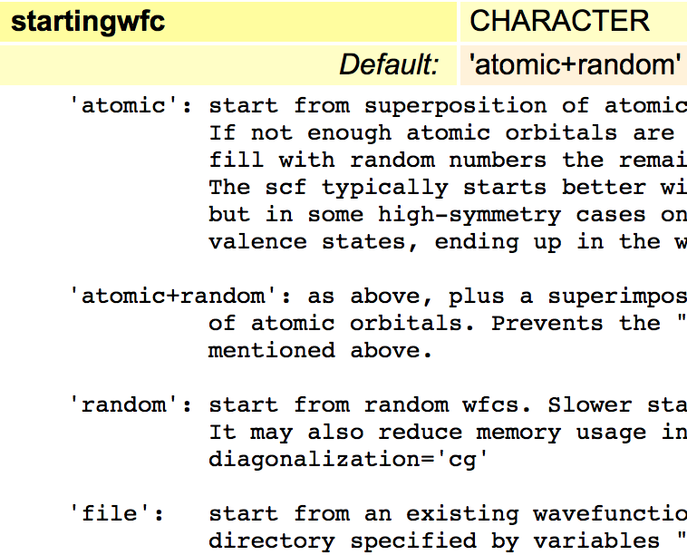
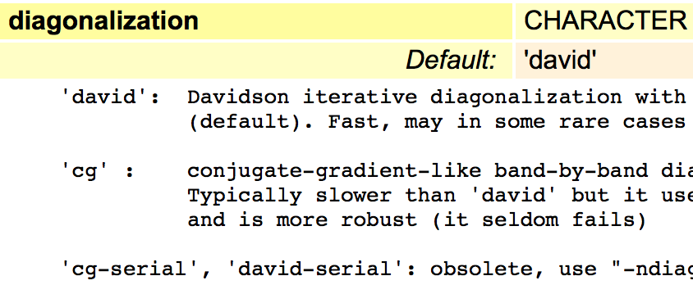
Pw.x input description - electrons

Slide 11
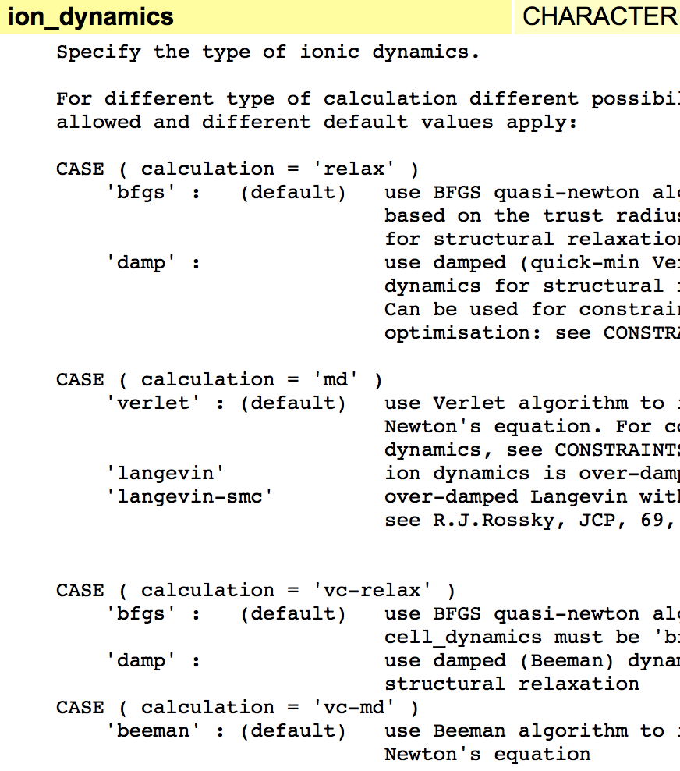
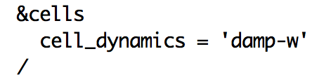
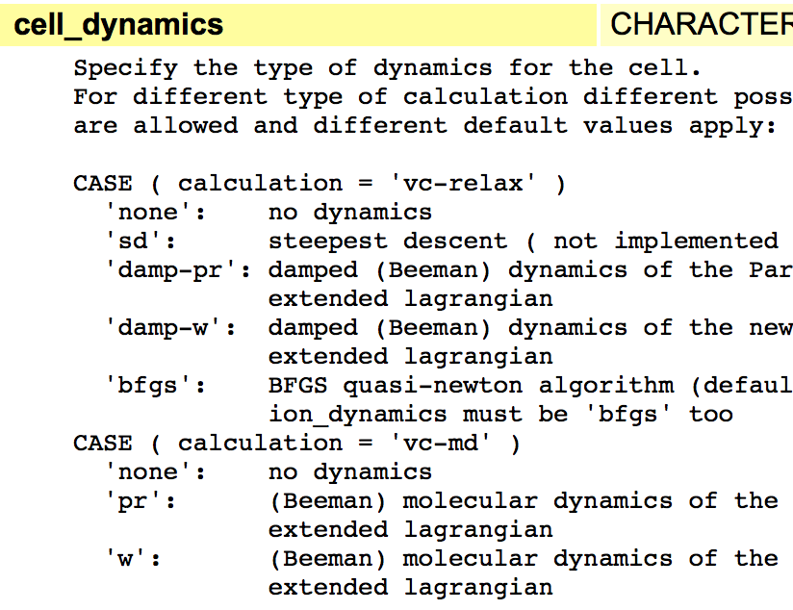
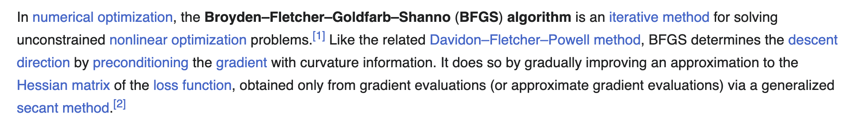
Pw.x input description – ions & cells
Thermostat, constraint

Slide 12
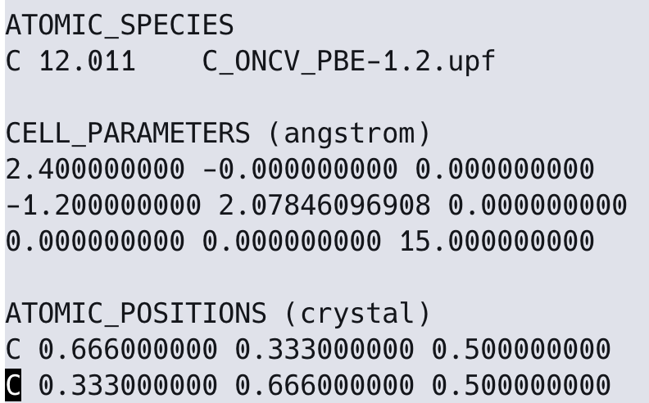
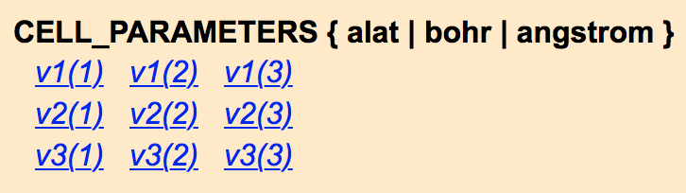
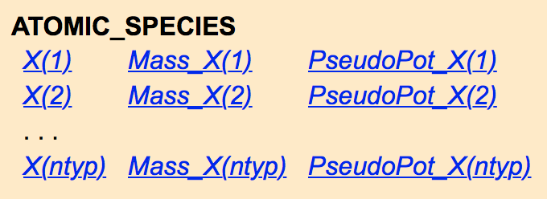
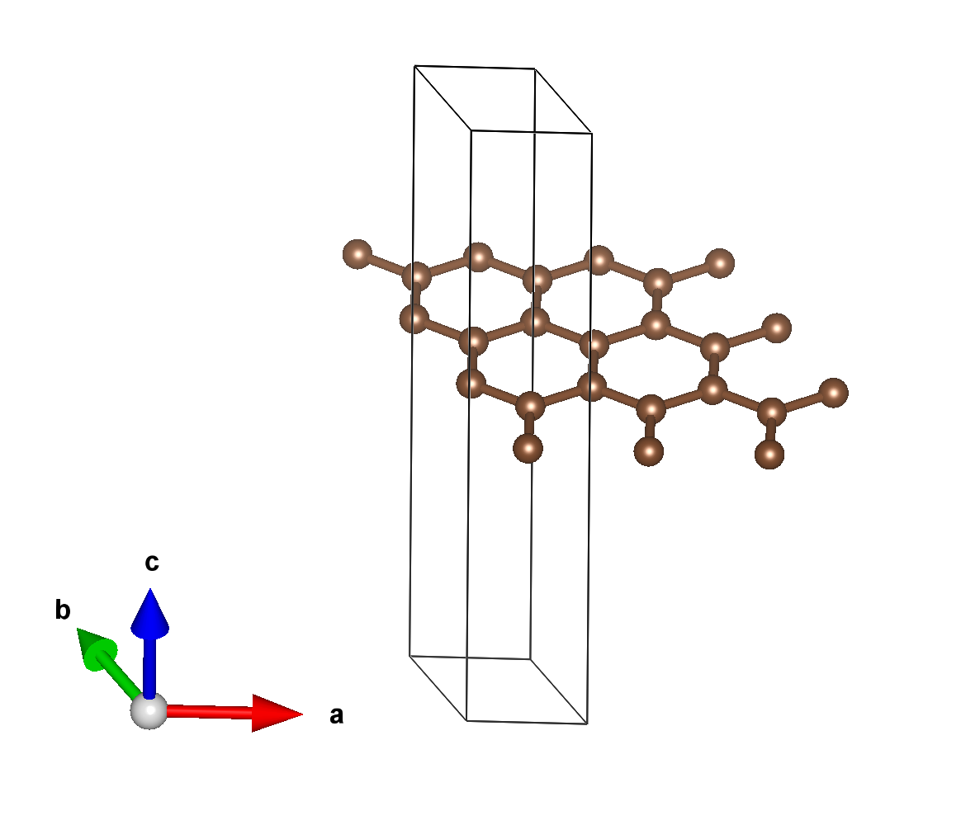
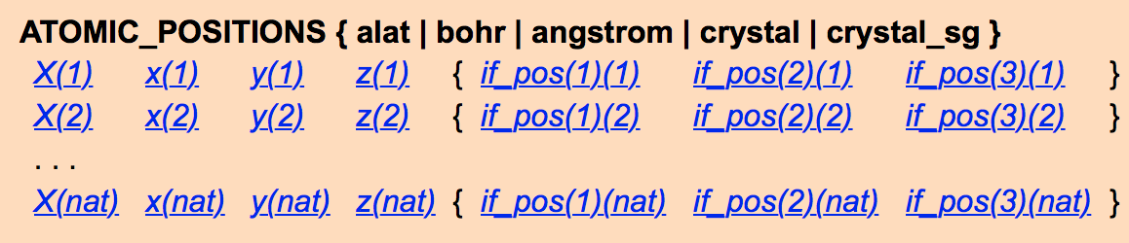
Pw.x input description - Structure

Slide 13
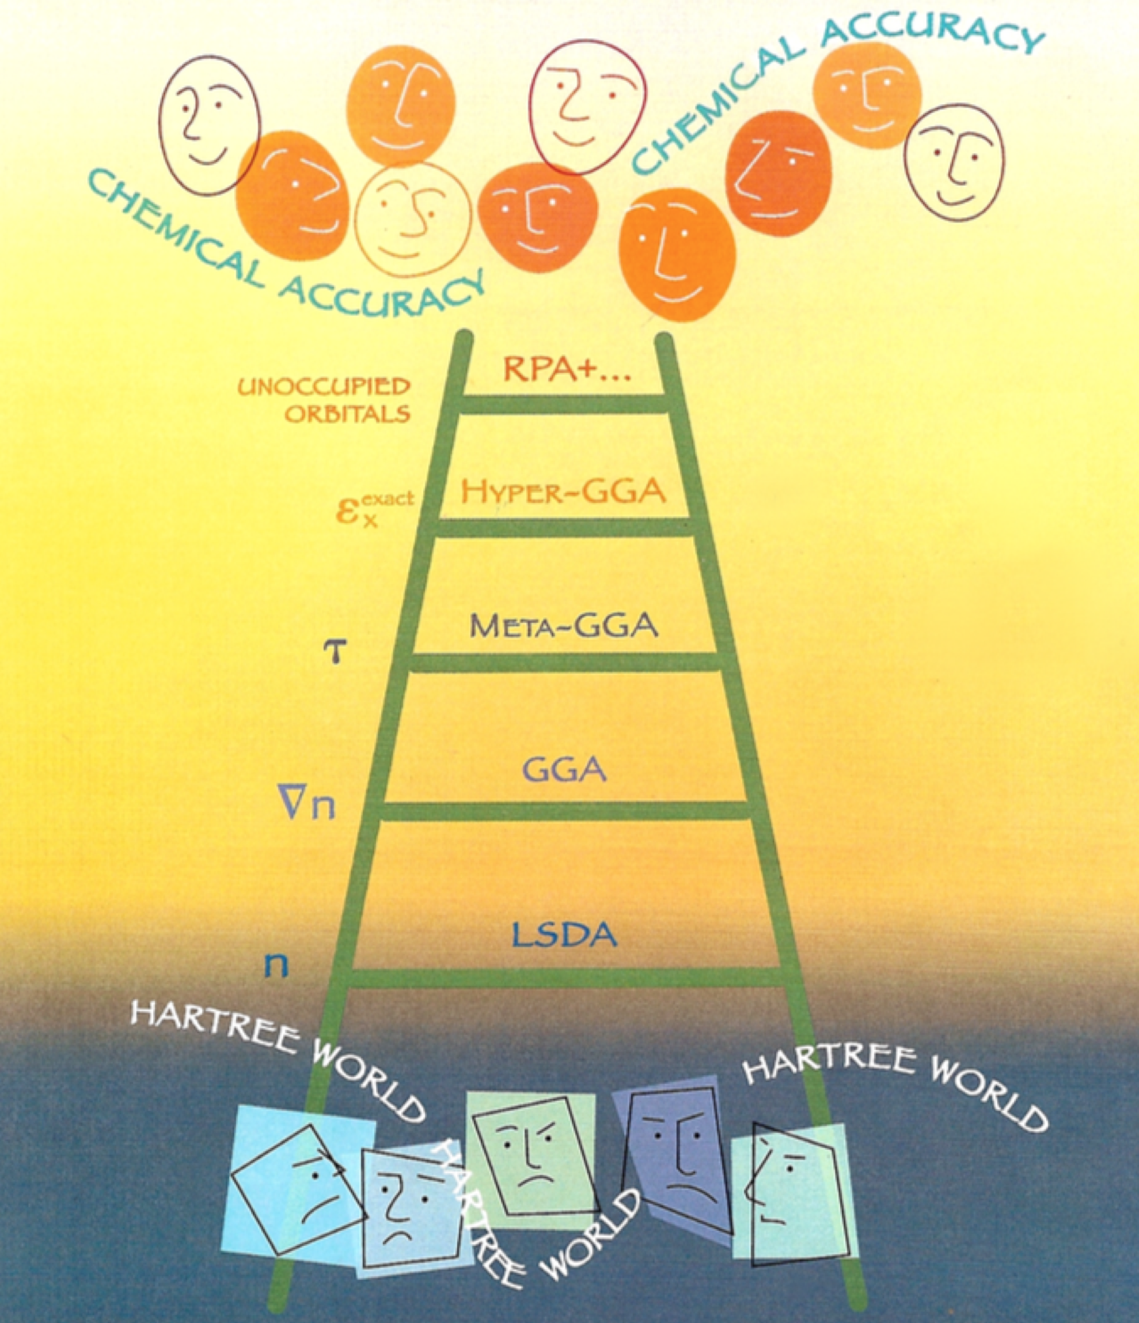
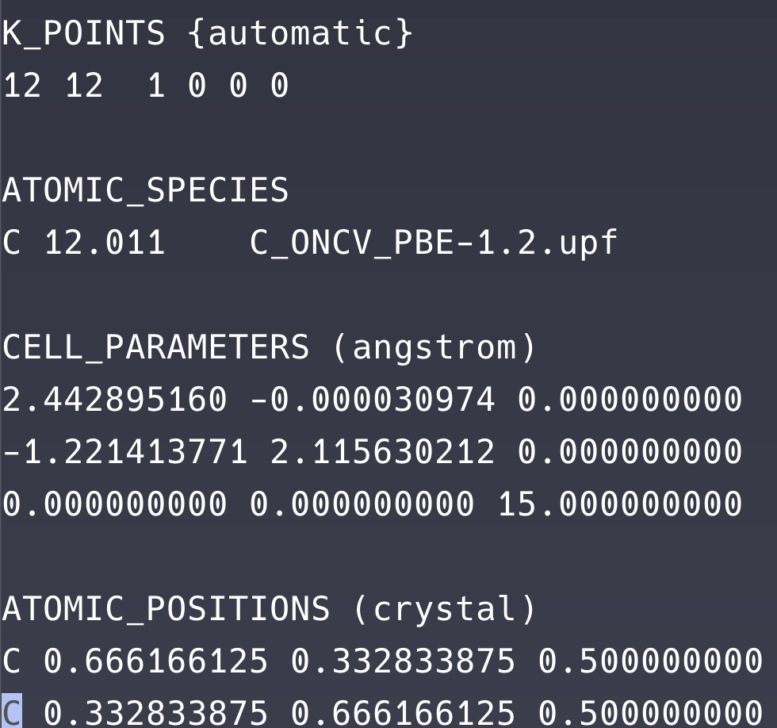
Pw.x input description - Funtional
LDA : PW, PZ, CA, VWN
GGA : PBE, PW91, BLYP
Meta-GGA : TPSS, MBJ
Hybrid : PBE0, B3LYP

Slide 14
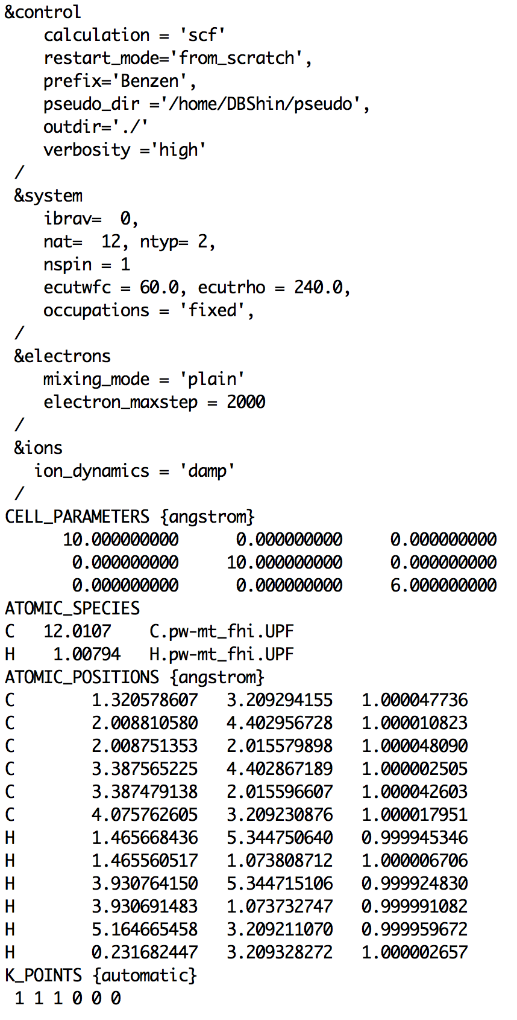
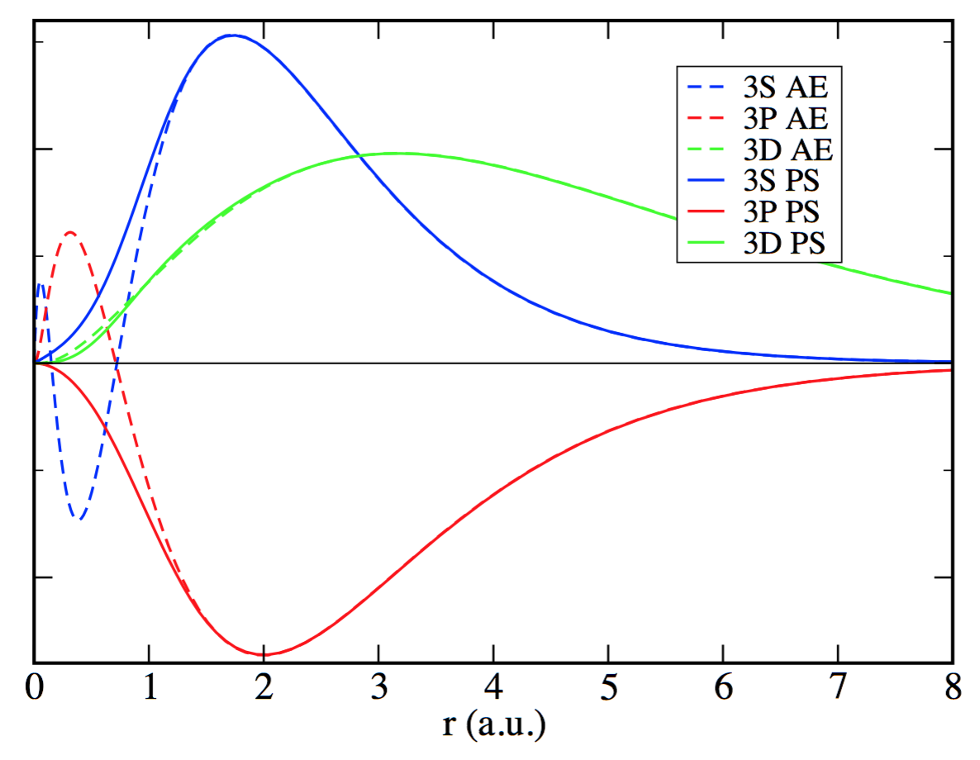
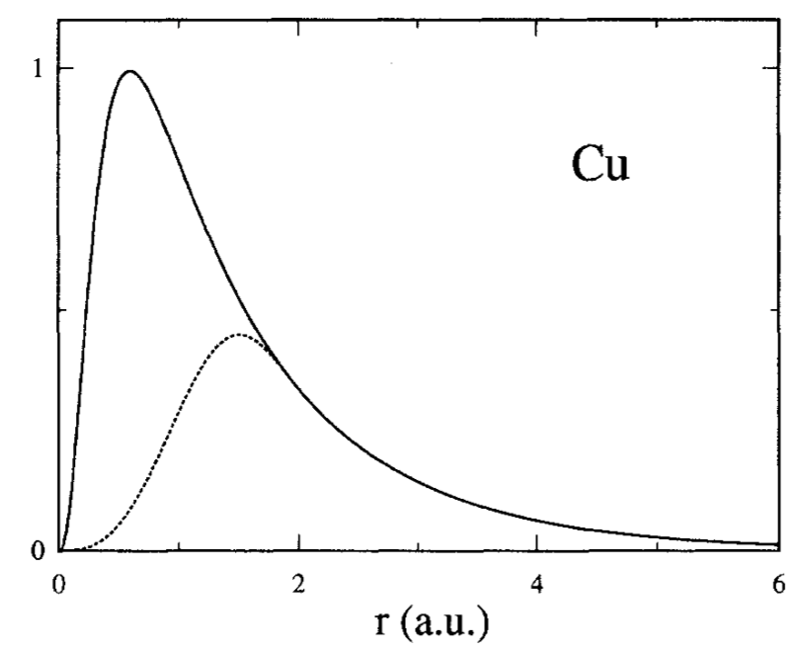
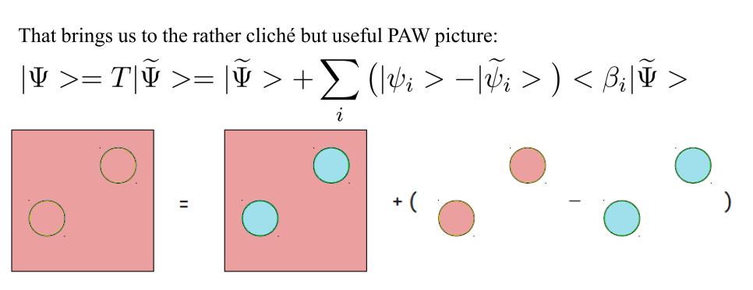
Pw.x input description - Pseudopotential
Norm-conserving pp
Ultrasoft pp
Projector augmented wave
ld1.x

Slide 15
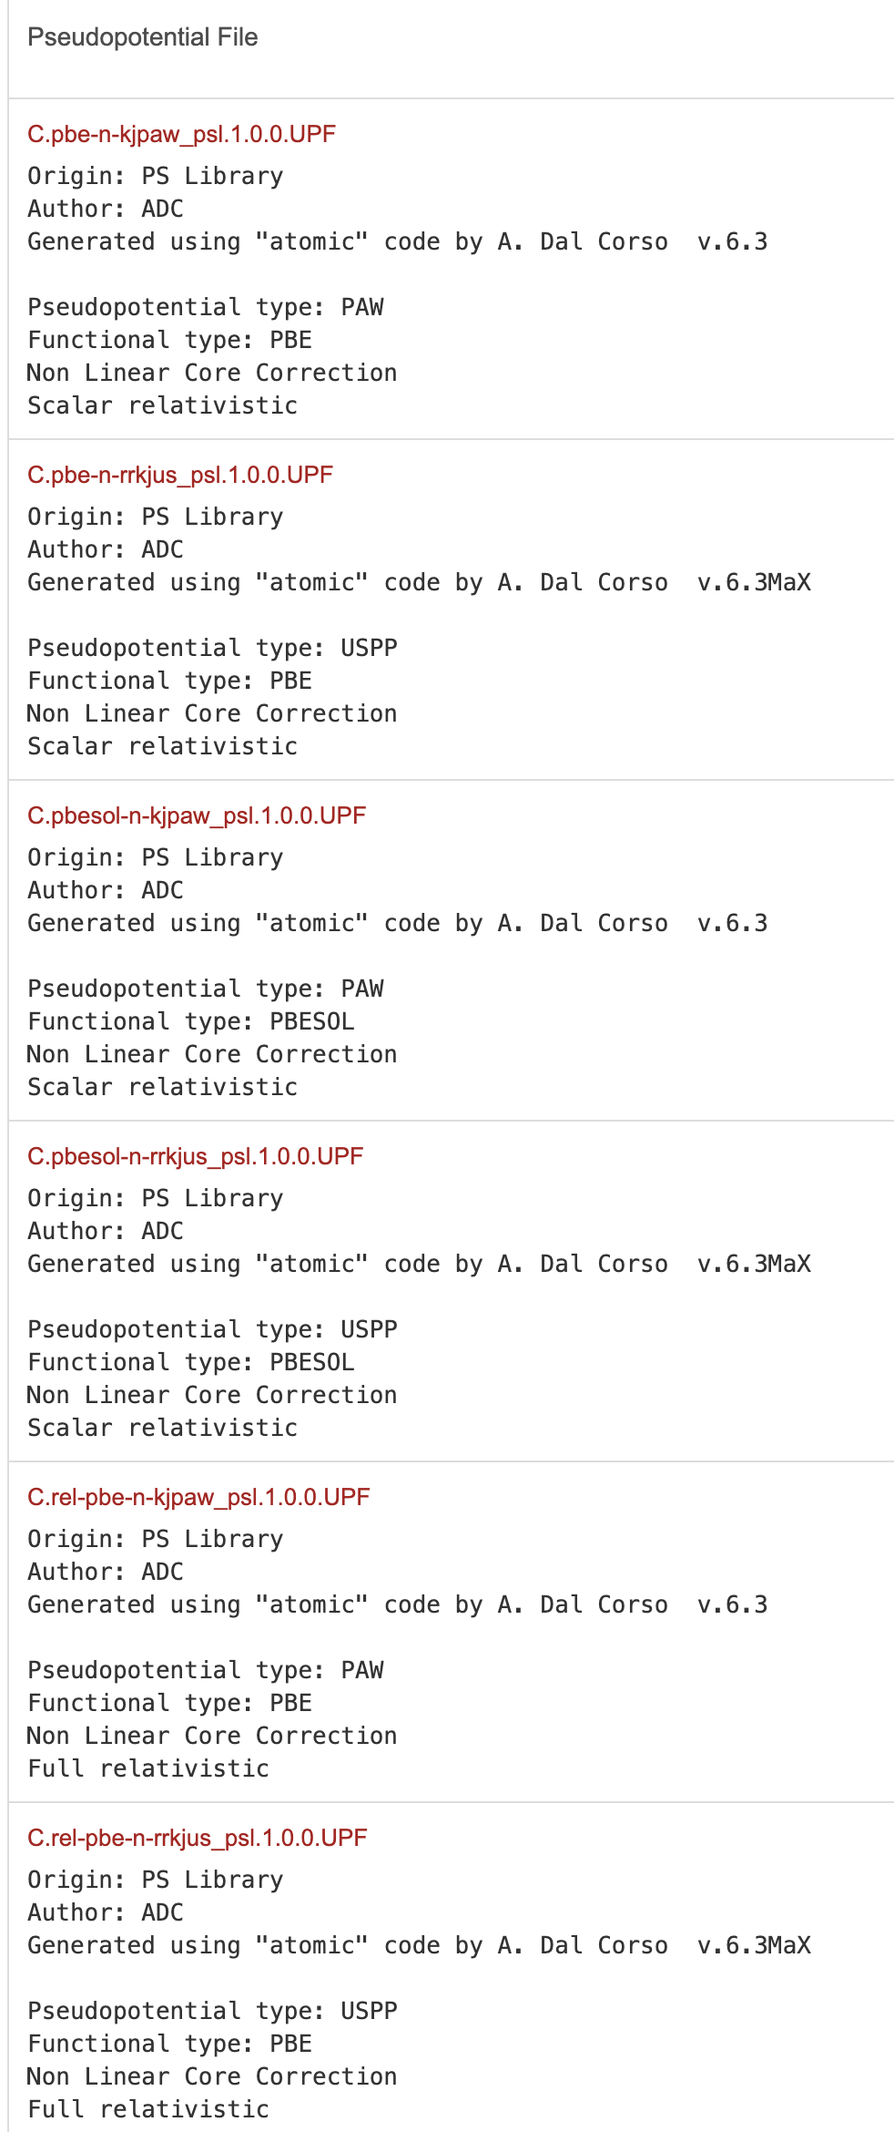
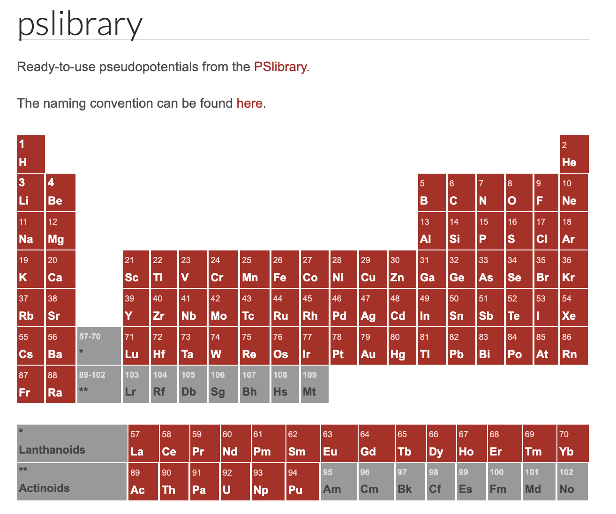
Pw.x input description - Pseudopotential
https://pseudopotentials.quantum-espresso.org/legacy_tables

Slide 16
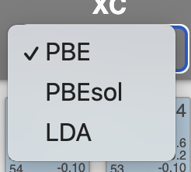
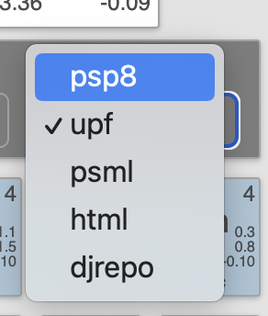
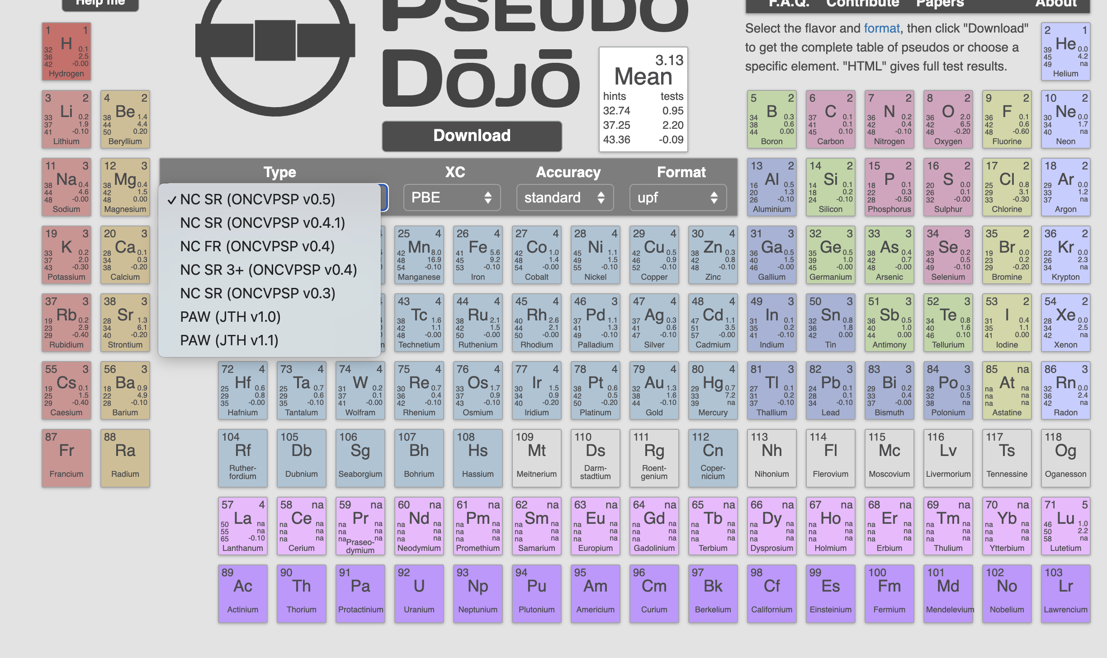
Pw.x input description - Pseudopotential
https://www.pseudo-dojo.org/

Slide 17
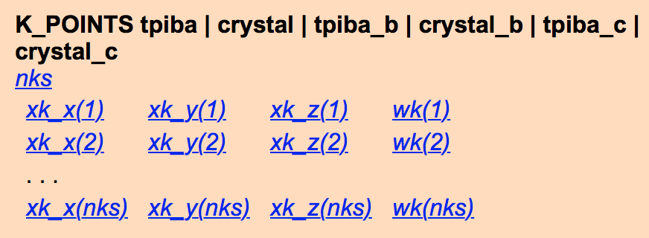







Pw.x input description – K-points

Slide 18


Pw.x running job - parallelization
mpirun -np 16 ~/q-e-qe-7.4/bin/pw.x
–nb 1 –nk 2 –nd 1 –nt 1 <./scf.in >./scf.out
Plane wave parallelization : default
nb : band parallelization
nk : k-point parallelization
nd : diagonalization parallelization
nt : task group parallelization

Slide 19




Pw.x output
scf.out
Front of output
SCF iteration
Eigen value and total energy

Slide 20


Pw.x output
pp.x
projwfc.x
neb.x
prefix.save
prefix.wfc1
…
prefix.wfc#
cp.x
pw.x
xspectra.x
prefix.xxx..
scf.in
scf.out
td.x
ph.x

Slide 21


DFT – Band structure
pw.x scf-from scratch
sampled k-points by Monkhorst pack
pw.x scf-restart
Specific Brilliouin zone path
bands.x
band_plot.x

Slide 22





DFT – Density of states
projwfc.x

Slide 23



DFT – Partial charge density
HOMO
LUMO
pp.x

Slide 24







DFT – Nudged elastic band
+ pw.x inputs
J. Chem. Phys. 113, 9978 (2000)
neb.x

Slide 25



DFPT – Phonon and el-ph interaction
ph.x
q2r.x
matdyn.x
lambda.x
Dorj Odkhuu, Dongbin Shin, Rodney Ruoff, and Noejung Park Scientific reports 3, 3276 (2013)

Slide 26


DFPT – Phonon and el-ph interaction
Dorj Odkhuu, Dongbin Shin, Rodney Ruoff, and Noejung Park Scientific reports 3, 3276 (2013)

Slide 27


DFT – Ab initio molecular dynamics
Oscillating saw-tooth type E-field
Masood Yousaf, Dongbin Shin, Rodney Ruoff, and Noejung Park JPCL 6, 5094 (2015)

Slide 28




Real time propagation TDDFT
Dongbin Shin, Geunsik Lee, Youshiyuki Miyamoto, and Noejung Park JCTC 12, 201 (2016)

Slide 29




